Slide 1
Website Personalization
Niet langer optioneel?
Martijn Janssen
Strategic Partnerships EMEA
martijn.janssen@optimizely.com
13 September 2016, Amsterdam

Slide 2
Optimizely: Experiment Everywhere 2016
SOLUTIONS
Web
iOS
Android
Server
PROJECTS
Web
iOS
Android
Custom
PLATFORM
Notes:
Today, through Optimizely, you can do client-side optimization and persoanlization via web and mobile. Additionally, we’re in private Beta with customers currently using our newest product, Server-Side Optimization. This takes optimization past the client-side limitations, and enables customers to truly test everywhere.

Slide 3
Optimizely: Experiment Everywhere 2017
SOLUTIONS
Web
iOS
Android
Server
OTT
Email
Store
PROJECTS
Multichannel
PLATFORM
Notes:
And where are we going in the next 6-12 months? We’ll be able to truly take optimized experiences to the next level, including personalizing on OTT, email, and in store experiences. Wherever you have a digital touchpoint with a customer, Optimizely can power the ideal customer experience.

Slide 4
Personalization: The challenge

Slide 5
89%
of companies surveyed by Gartner believe that customer experience will be their primary basis for competition in 2016 and beyond
Source: Gartner, Inc., Gartner Predicts a Customer Experience Battlefield, February 2015

Slide 6
8
seconds
Source: Microsoft Research, Spring 2015
Notes:
But why is that important, and why am I showing you an image of a goldfish? microsoft recently released a survey showing that hte average consumer visiting a website has the attention span of 8 seconds, just 1 second less than a goldfish
In fact, Research by Microsoft found that since the year 2000 the average attention span dropped from 12 seconds to eight seconds
This is largely because of the accelerating pace of change of new technologies
LINK to research in case it is needed for follow up: http://advertising.microsoft.com/en/cl/31966/how-does-digital-affect-canadian-attention-spans

Slide 7
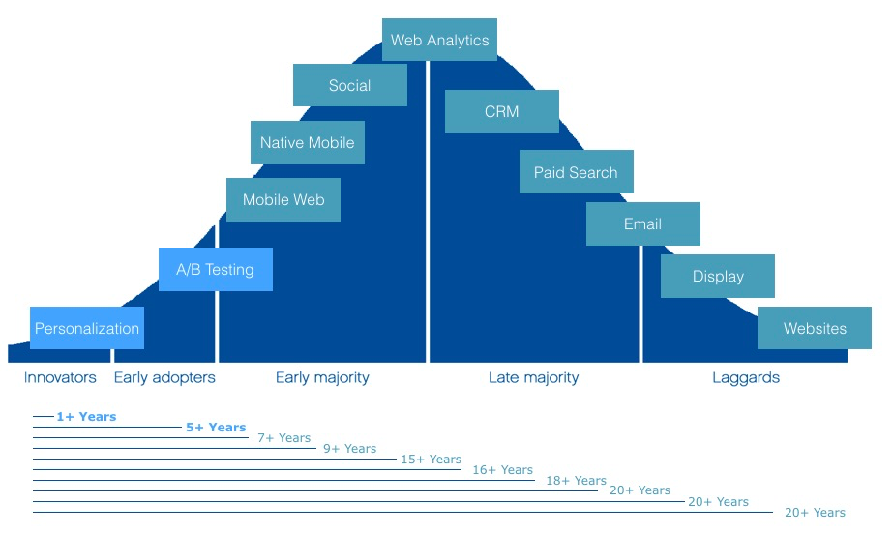
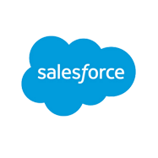
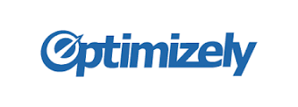
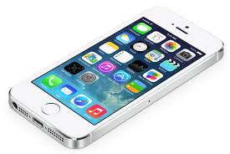
Social
Web Analytics
Native Mobile
CRM
Mobile Web
Paid Search
A/B Testing
Email
Display
Personalization
Website
INNOVATORS
EARLY ADOPTERS
EARLY MAJORITY
LATE
MAJORITY
LAGGARDS
1+ YEARS AGO
3+ YEARS AGO
5+ YEARS AGO
9+ YEARS AGO
15+ YEARS AGO
20+ YEARS AGO
Notes:
When we look at just how quickly digital technology has evolved over the last 18 years, with the proliferation of devices and digital channels, it’s easy to see why consumers’ attention spans are dropping. Let’s take a look at this of our favorite technology companies:
For example, google was founded in 1997, or 18 years ago, giving us paid search.
-sfdc, largest crm company in the world, was founded in 1999.
-facebook started opening up to the general public in 2006.
-2008 iphone was launched, revolutionizing our mobile communication and connectivity habits.
And finally, we look at the innovators and early adopters today, and we have experience optimization, or personalization and a/b testing, which is the marketing discipline that has been created to fight for consumer’s attention.
if we think about what’s been happening and this fight for consumer’s attention, it’s important to note that as we look at the optimizaiotn inudstry on the adoption curve it’s still very new and adoption is still very low, but that’s changing rapidly.
-now, let’s look at how some of our favorite companies have evolved along this adoption curve.

Slide 8
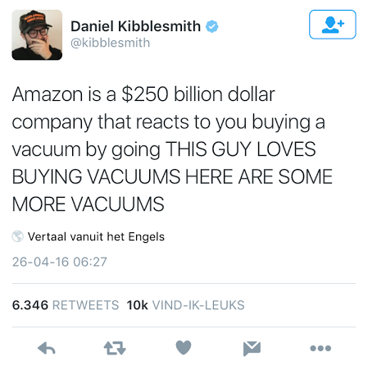

Slide 9
The value of Personalization

Slide 10
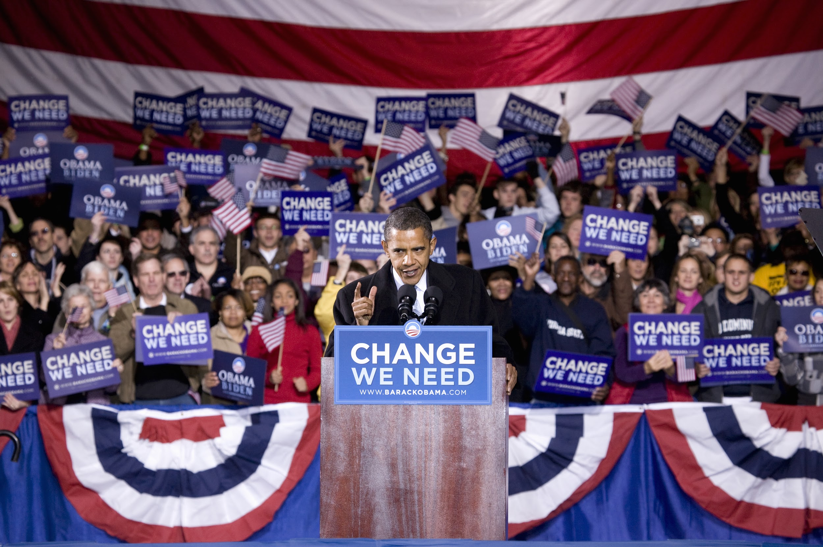
Notes:
Let’s talk politics.
The presidential election has heated up in the states, and while it looks quite different than our 2008 and 2012 elections, it took notes from Obama’s digital strategy.
2012 presidential election was a tight race. To fuel the campaign, the Obama team optimizated and tested absolutely every aspect of the campgaign’s fundsraising and volunteer effots. Over the course of 20 months, the team executed about 500 tests that increased donation conversions by 49% and sign up conversions by 161%, fueling Obama’s grass roots efforts

Slide 11
Unregistered
Users
Registered
Users
Returning
Donors
0.0%
0.0%
0.0%
+2.3%
+27.8%
+16.3%
-27.8%
N/A
N/A
+15.2%
-24.6%
+11.9%
+8.5%
+2.9%
+18.4%

Slide 12
What do you know about your visitors?
Notes:
For Optimizely, Personalization is much more than just a product recommendations box on your site. It’s about creating a user experience that’s tailored to your most valuable visitors
So let’s meet Jane.
If Jane walked into your store, your salesperson would immediately know she was a young woman. They might ask her a few questions about what she’s looking for today, and pick up on the signals she is sending to be able to tailor the experience.
But on your website, Jane is anonymous. She sees the same thing as everyone else. And you have 8 seconds to capture her attention before she navigates away from your site, only to go find a better sale offer somewhere else.

Slide 13
What do you know about your visitors?
Context
What’s unique about the visitor right now
Examples:
Marketing campaign
Referral source
Device
New/Return visitor
In Los Angeles
Browsing on her mobile phone today
Clicked on Facebook ad
Notes:
So let’s go back to Jane, what is she actually telling you with the signals she is sending, and how can you leverage those signals to deliver her a personalized experience?
There are several types of signals to look for, that you can use for targeting.
The first is contextual. This tells you what’s unique about Jane right in this moment. These are often changing quickly.

Slide 14
What do you know about your visitors?
Behavior
Infer the visitor’s intent from their actions
Examples:
Viewed certain products or pages
Abandoned cart
Downloaded specific content
Browsed products with certain prices
Viewed 5 different shoes in past 3 days
Left shoes in cart yesterday
Notes:
Behavior is a high indicator of intent.
Behavioral audiences are defined entirely by you, based on which behaviors you determine are important indicators.
e.g. One of our customers analyzed their web traffic and purchases and determined that browsing a product page once was not a good signal of intent to purchase, but visitors who returned to the same product page at least 3 times were much more likely to complete the purchase.
You will use personalization software to target key behaviors.

Slide 15
What do you know about your visitors?
Demographics
Target content based on the visitor’s demographic profile
Examples:
VIP customer
Gender
Industry
Income profile
Single female, 25-34
Loyalty program member

Slide 16
Create a complete view of Jane you can take action on
In Los Angeles
Viewed 5 different shoes in past 3 days
Purchased shoes last time they were on sale in store
Single female, 25-34
Browsing on her mobile phone today
Loyalty program member
It’s raining
Notes:
We call this a Dynamic Customer Profile
Dynamic Customer Profiles enable you to provide Jane with a tailored digital experience based on her historical interactions with your brand coupled with her real time behavior on your digital channels.

Slide 17
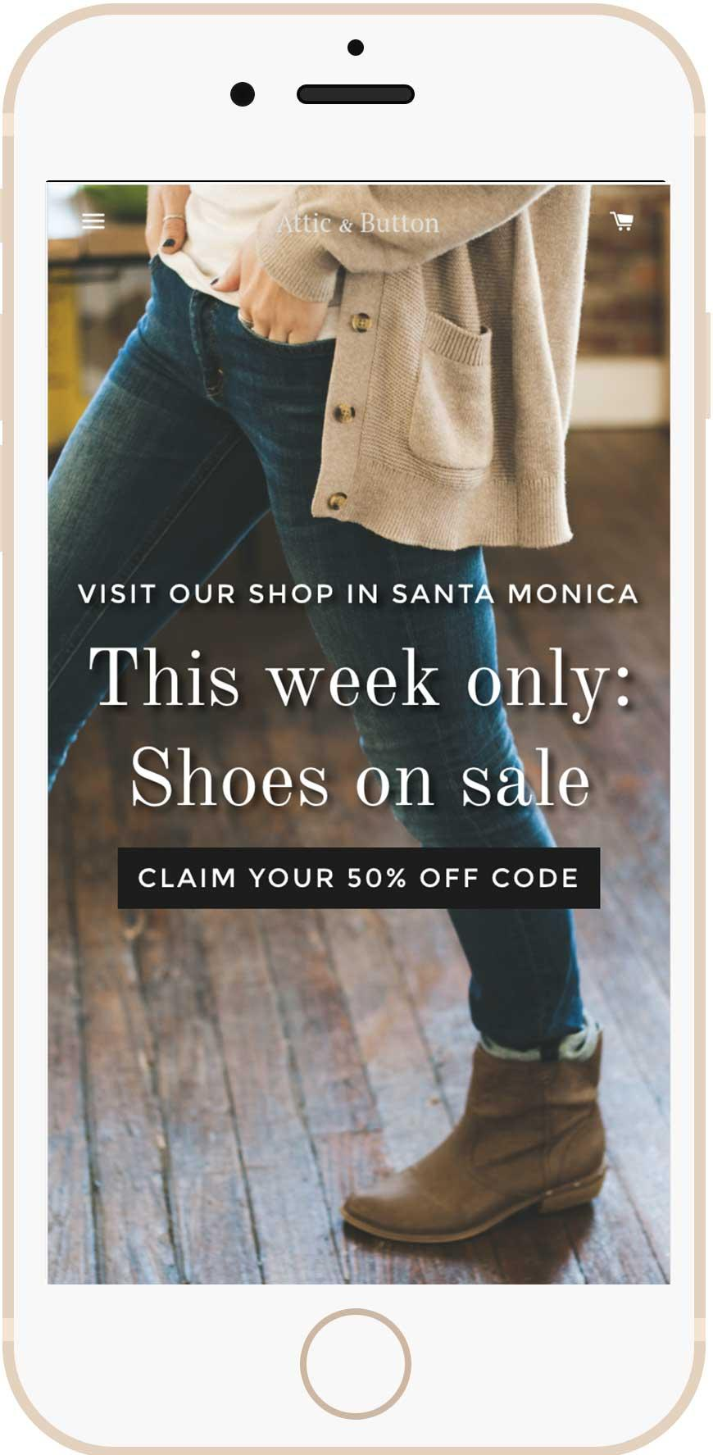
Signals you can use to deliver her a relevant experience…
Browsing on her mobile phone today
In Los Angeles
Viewed 5 different shoes in past 3 days
Loyalty program member
Notes:
Here you can read the signals Jane is sending, and serve her an experience on her phone, pushing her into your store, with a coupon for just what she was browsing.

Slide 18
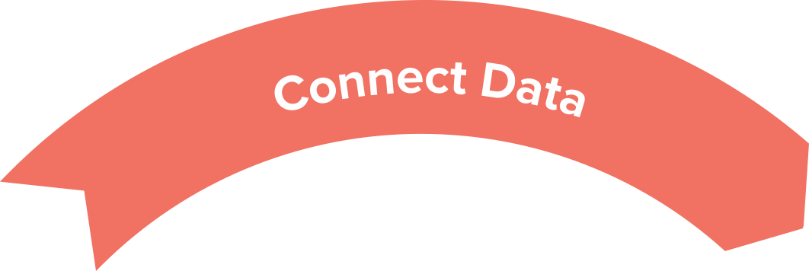
Integrations
Visual Tagging
Customer Profiles
Insights
APIs & Developer Tools
Audience Explorer
Stats Engine
Desktop Web
Mobile Web
Mobile Apps
Predictive Analytics
Lift Measurement
World-class Infrastructure
Audiences
A/B & MVT Tests
Personalized Campaigns
Behavioral Targeting
Notes:
This is the Optimizely Experience Optimization Platform
Personalization joins Testing as our second product to help you complete this loop, and deliver on the promise of turning data into action. Because the two products are built on the same Experience Optimization Platform, they share the same audiences, integrations, APIs, and snippet.
Experience Optimization is Experience Optimization is the discovery and deployment of the best digital experiences for every customer across the web and mobile apps.
It’s a process, a closed loop, and the faster you can connect each of these pieces, the more benefits you can see to your team’s efficiency and ability to get more value.

Slide 19
Personalization Where to get started?

Slide 20
Where to start?
3 Simple use cases: - Symmetric Messaging
- Product Interest pushes
- Target customer segments
Notes:
Behavior is a high indicator of intent.
Behavioral audiences are defined entirely by you, based on which behaviors you determine are important indicators.
e.g. One of our customers analyzed their web traffic and purchases and determined that browsing a product page once was not a good signal of intent to purchase, but visitors who returned to the same product page at least 3 times were much more likely to complete the purchase.
You will use personalization software to target key behaviors.

Slide 21
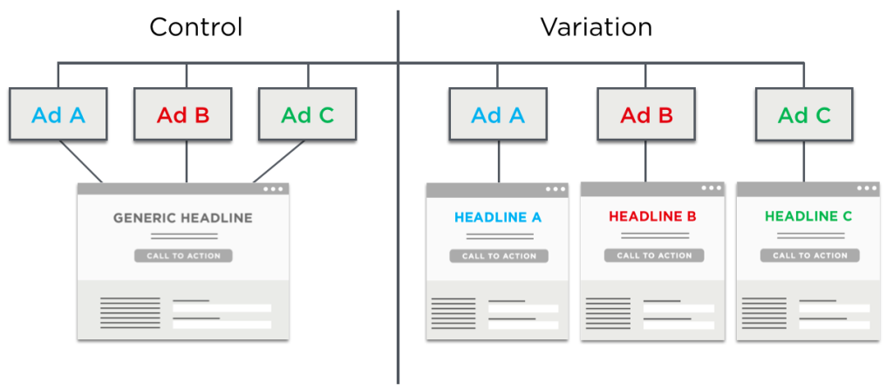
Symmetrical Messaging

Slide 22
Symmetric messaging helps them get more from AdWords spend.
Personalized campaign
Matched landing page copy and imagery to AdWords campaigns.
Results
32% increase in new sign-ups
No added cost for AdWords spend, yet more value from converted traffic

Slide 23
Behavioral retargeting produces 4x ROI
Personalized campaign
Used behavioral targeting to show buy-one-get-one tire promotion to customers who had viewed tires.
Results
21% increase in overall site sales
Sold out of tire stock 2 months before expected
4x return on investment in Optimizely and solutions partner services
Notes:
Our customer Specialized Bikes saw value from a personalization campaign they ran with the help of roboboogie, a solutions partner agency.
Behavioral retargeting is one primary way to get value from Personalization. With behavioral retargeting, you identify visitors who have expressed interest in a particular product, then retarget them with an offer that is relevant to their interest. Optimizely Personalization makes this exceptionally fast.
Details of campaign:
First they created an audience, by setting up tracking to capture information on which visitors were browsing for tires.
After capturing interest for a month, they had an audience for the offer
Showed a buy one get one promotion for road tires specific to desktop or mobile to this particular audience.
Results
The strategic messaging addition boosted add to carts by 11.4 percent on desktop and 7.3 percent on mobile.
Personalization efforts boosted add to carts by 18.1%, and overall site sales by 21.4%.
Revenue generated through personalization experimentation alone has provided more than four times the monthly combined cost of Optimizely platform and agency services.
NOTE: Specialized and Roboboogie used the Testing product for this particular campaign, because it ran prior to Personalization availability. Position this as value that they got from the practice of lower-case p personalization, rather than from the Personalization product.

Slide 24
Personalized content reduces length of buyer’s journey to purchase.
Personalized campaign
Industry-specific content on homepage to reduce bounce rate due to irrelevant content
Results
Personalized homepage for healthcare, finance, and education
Decreased bounce rate by 7%
Increase in pageviews/session by 10%
30% increase in clicks on the banners
Notes:
Citrix:
Global $3B+ revenue company
Vision: personalize digital experiences to each visitor
They do it using Optimizely and Demandbase
Prospects spend a lot of time researching on your website in B2B space. For Citrix, personalizing the content on the website is important to accelerating the buyer’s journey from research to sale.
What they did
Created a personalized version of their homepage for different types of customers by industry (healthcare, finance, education)
Results
The results were staggering. The personalized experiences accounted for huge improvements in visitor engagement across all three target industries.
Personalization of Citrix’s homepage resulted in:*
An overall decrease in bounce rate by 7%
30% increase in clicks on the homepage banners
10% increase in pageviews per session, indicating that visitors were navigating to more pages after they saw a more personalized homepage experience
4% increase in average session duration, indicating that not only were visitors seeing more pages, but they were also spending more time on the site and consuming more information
*average results across the three personalization campaigns

Slide 25
Thank you!
Martijn Janssen
Strategic Partnerships EMEA
martijn.janssen@optimizely.com
13 September 2016, Amsterdam

